Slide 1

Outcomes of Democracy: Measuring Accountability, Growth, and Freedom

Slide 2


How Do We Assess Democracy’s Outcomes?
Evaluating the success of democracy extends beyond the mere holding of elections. It requires a deep dive into its tangible impacts on governance, society, and the economy.
Accountable Governance
Tangible Outcomes
Beyond Elections
Democracy's success hinges on whether it fosters governance that is accountable to its citizens, responsive to their needs, and legitimate in its exercise of power.
Key outcomes include sustainable economic growth, significant poverty reduction, inclusive social development, and the unwavering protection of citizen dignity and fundamental freedoms.
True assessment necessitates looking beyond periodic elections to scrutinise the real, everyday impacts of democratic processes on societal well-being and economic prosperity.

Slide 3


Accountable, Responsive, and Legitimate Government
Democratic systems inherently foster an environment where public scrutiny is encouraged, thereby significantly reducing instances of corruption and the misuse of power. This transparency empowers citizens and civil society organisations to hold their leaders responsible.
For instance, democratic governments are more prone to facilitate the establishment of robust labour rights and ensure equitable access to education. As noted by Trinugroho (2023), such measures are crucial in empowering marginalised groups, giving them a voice and opportunities within the system.
The legitimacy of a government in a democracy fundamentally stems from the integrity of free and fair elections, the consistent application of the rule of law, and an unwavering respect for human rights and individual liberties.
Empowering Citizens
Democratic frameworks enable citizens to actively participate in governance, fostering a system where power is derived from the people and exercised for their benefit.

Slide 4
Democracy and Economic Growth: Complex but Positive Link
While the relationship between democracy and economic growth is intricate, long-term studies consistently highlight a positive correlation.
20%
Boost
Challenges
GDP Per Capita Increase
Investment & Reforms
Short-Term Hurdles
Long-term studies indicate that democracy can increase a nation's GDP per capita by approximately 20% over several decades (Restrepo et al., 2019), reflecting sustained economic progress.
Democracy tends to encourage greater domestic and foreign investment, promote widespread schooling, and drive critical economic reforms, alongside reducing social unrest for stability.
However, the establishment of democracy can present certain costs and transitional challenges that might temporarily slow down short-term economic growth (Trinugroho, 2023).
This complex interplay signifies that while initial phases may be challenging, the enduring benefits of democratic institutions often lead to more robust and equitable economic development.

Slide 5

Economic Outcomes: Inequality and Poverty Reduction
One of democracy's fundamental aspirations is to foster more equitable societies. Democracies generally tend to reduce income inequality by championing policies that promote universal access to education and secure labour rights for all citizens.
Nevertheless, significant economic inequality continues to persist in many democratic nations. This disparity poses a considerable threat to the very stability and foundational principles of democracy itself (Rau, 2025).
Therefore, the deliberate implementation of policies specifically targeting the reduction of inequality is not merely an economic imperative, but a strategic move to strengthen democratic resilience and expand economic freedom for everyone (Islam, 2018).
Promoting economic inclusivity through democratic means is vital for long-term societal harmony and stability.

Slide 6



Accommodating Social Diversity
Democracies, by design, offer an institutional framework that provides essential space for various ethnic, racial, and social groups to actively participate in the political process and contribute to societal discourse.
Inclusive Participation
Addressing Challenges
Key to Managing Diversity
Democratic frameworks encourage and facilitate the active involvement of diverse social groups in political and civic life, ensuring their voices are heard.
Despite these efforts, challenges such as historical legacies of discrimination and unequal access to opportunities can still marginalise minority communities (Brookings, 2022).
Implementing political decentralisation alongside crafting genuinely inclusive policies are crucial strategies for effectively managing and celebrating societal diversity.
Embracing and integrating diverse perspectives is not only a moral imperative but also a source of strength and innovation within a democratic society.

Slide 7




Dignity and Freedom of Citizens
At its core, democracy serves as the ultimate guardian of civil liberties, ensuring fundamental rights such as freedom of speech, association, and the crucial right to vote for every citizen.
Protecting Freedoms
Undermining Rights
Ensuring Equal Voice
Democracy is committed to upholding fundamental civil liberties, including the vital rights to free expression, peaceful assembly, and the essential right to cast a vote.
Practices such as voter suppression and systemic political inequality can severely undermine these cherished freedoms, disproportionately affecting marginalised communities (Equitable Growth, 2021).
Strengthening democratic institutions is paramount to guaranteeing the dignity of all citizens and ensuring every individual has an equal and respected political voice.
The continuous vigilance and active participation of citizens are essential to preserving and expanding these liberties for future generations.

Slide 8
The Risks: Inequality and Democratic Erosion
While democracy promises equality, persistent economic inequality poses a significant threat, often leading to a weakening of democratic foundations.
Income Disparity
1
High income inequality is strongly correlated with democratic backsliding, where established norms and practices begin to erode, jeopardising the integrity of the system (Rau, 2025).
Concentration of Power
2
When wealth and influence become concentrated in the hands of a small elite, it can severely weaken accountability mechanisms and reduce governmental responsiveness to the broader public's needs.
Legitimacy Crisis
3
Addressing pervasive inequality is not just an economic imperative; it is absolutely critical for sustaining the very legitimacy and stability of democratic governance in the long run.
Failing to address these disparities risks undermining public trust and the democratic compact itself.

Slide 9










Summary: Democracy’s Multifaceted Outcomes
Democracy offers a powerful framework for societal advancement, yet it constantly navigates a complex landscape of achievements and inherent challenges.
Economic Development
Accountable Governance
Promotes long-term growth and prosperity.
Fosters transparency and responsiveness in government.
Social Inclusion
Provides space for diverse participation.
Political Erosion
Risks due to power concentration.
Economic Inequality
A persistent challenge threatening stability.
To fully realise democracy's potential, continuous reforms and truly inclusive policies are indispensable, ensuring its benefits are shared by all sections of society.

Slide 10
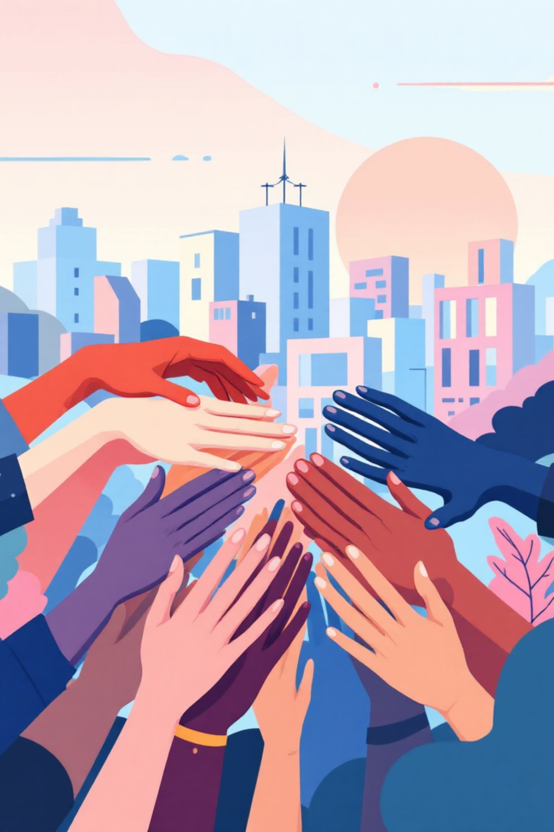



The Way Forward: Strengthening Democracy for All
The future of democracy hinges on proactive measures and collective commitment. By focusing on key areas, we can build more resilient, equitable, and free societies.
Invest in Human Capital
Empower Local Governance
Prioritise investments in education, coupled with dedicated efforts to significantly reduce inequality and rigorously protect all civil rights.
Actively promote political decentralisation, allowing for more localised decision-making, and implement truly inclusive governance practices.
Foster Active Engagement
The ultimate outcomes of democracy profoundly depend on vibrant, active citizen engagement and the enduring strength of resilient institutions.
Together, through these concerted efforts, we can truly build societies that are not only accountable and prosperous but also fundamentally free for every individual.

